Slide 1

Extracting Features from and Standardizing Phoneme Features
Mezisashe Ojuba
10th July 2024.

Slide 2
Feature Extraction
I looked into Kevin’s readme.
Kept running into errors (mostly things like text concatenation) and fixed them by hardcoding the specific lines giving issues, to run into another error.
The last error was that the wav file wasn’t in a recognized format though I tested the audioread function with a dummy file and it worked fine, and the data file opened correctly with media player.
Was not able to get any features.
Any grad student available to help?

Slide 3
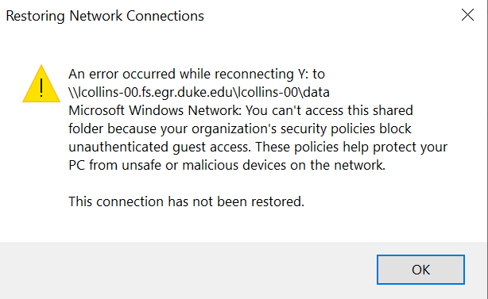
Using Remote Desktop for Processing Power
I cannot log into Batcave virtually
I may just need to get the keys. I have Cyndi’s email to follow up.

Slide 4
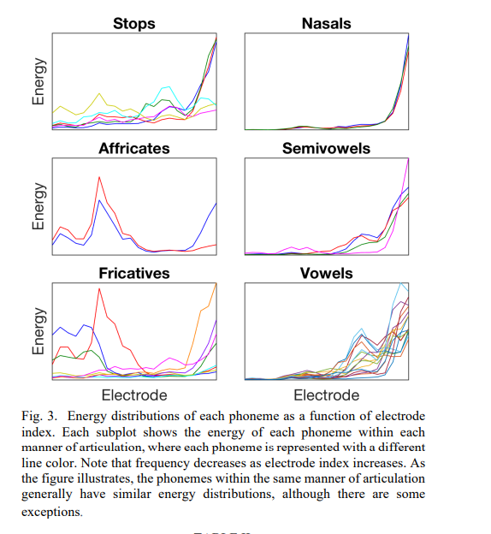
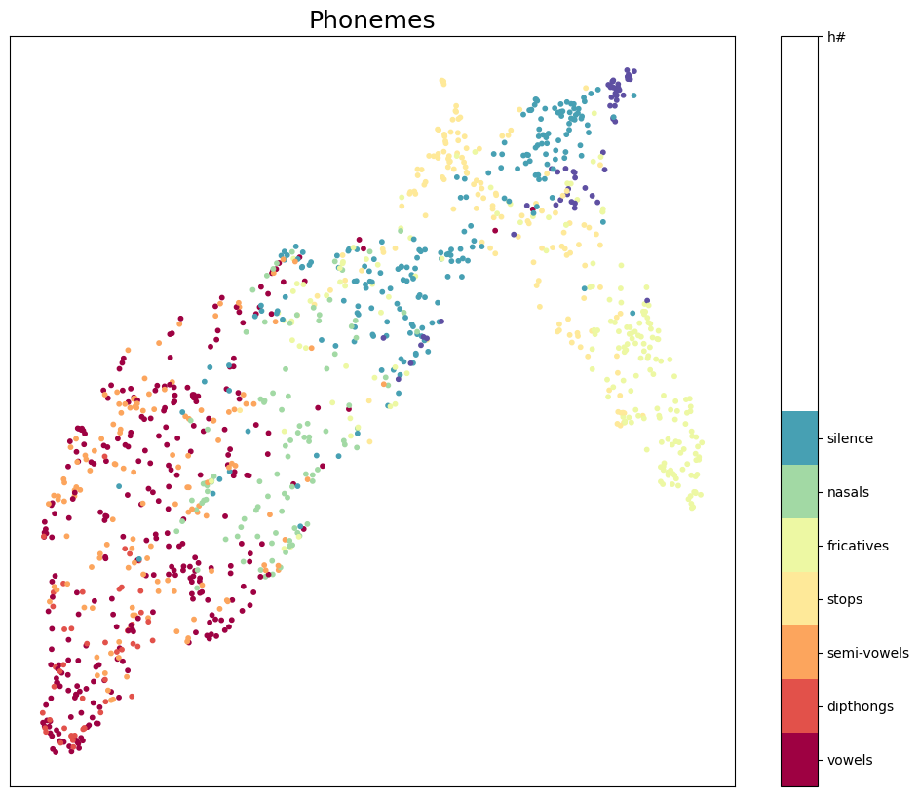
Feature Visualization according to Manner of Articulation [1]
Visualizing all 60 phonemes (colour-coded)

Slide 5
References
[1] https://ieeexplore.ieee.org/stamp/stamp.jsp?tp=&arnumber=4100697

